Slide 1


Conflicts, Cause of War in 19th and 20th Century
Capstone Project by Mehmet J Oguz
July 2019

Slide 2
Why do wars occur and recur?
Two prerequisites for a war between actors.
1- At least one sides that involved has to expect that the anticipated gains from a war in terms of resources, power, glory, territory.
2- Lack of ability to enforce or commit to an agreement

Slide 3
DATA
Correlates of War Data
Oslo Peace Research Institute's armed conflict data
Stockholm International Peace Research Institute's war data
Our World in Data

Slide 4
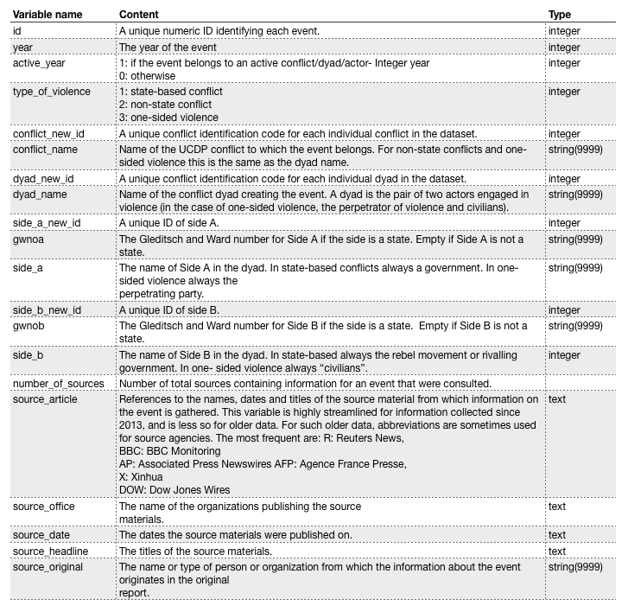
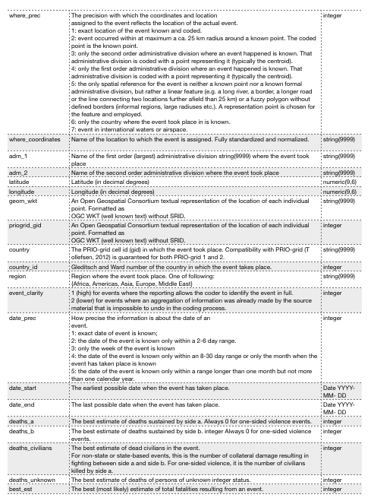
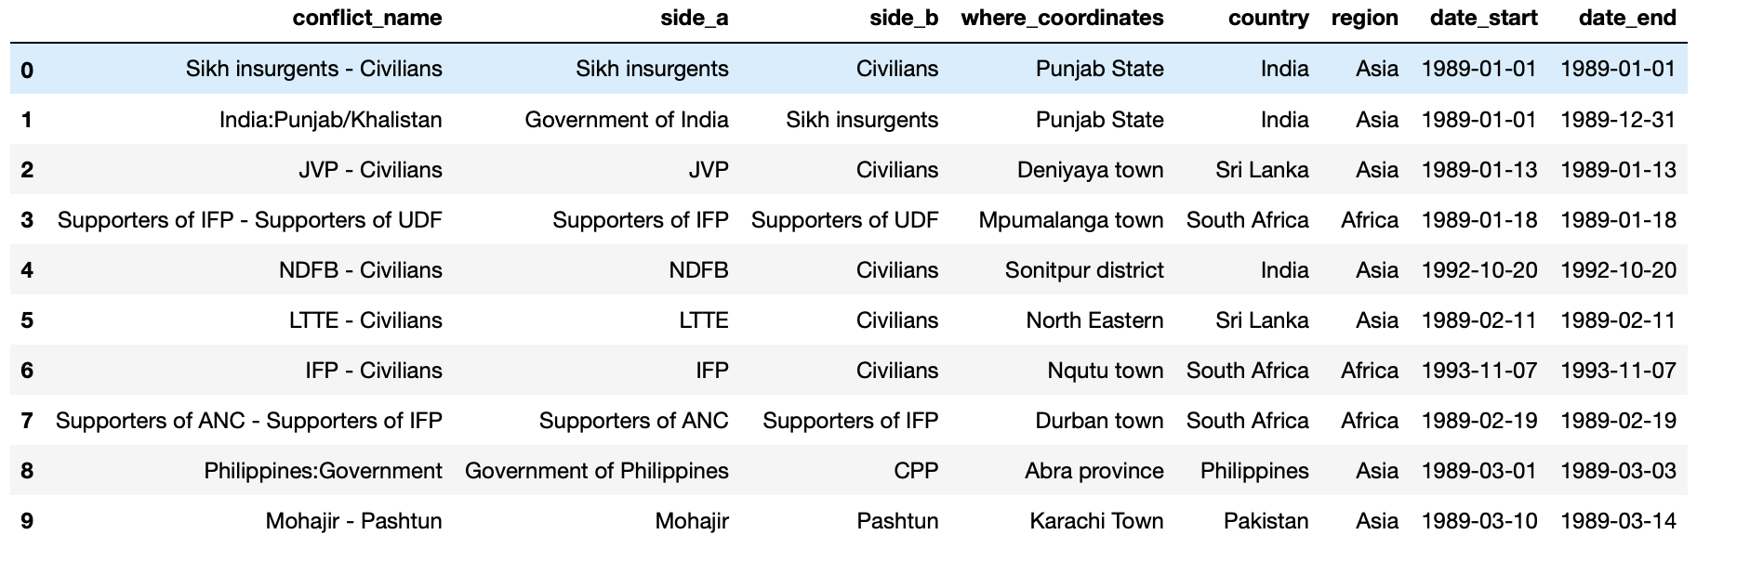
The variables included in the UCDP GED version 18.1:

Slide 5
Preparation
All datasets were explored with Pandas methods such as .head(), .info(), and .describe(), and DataFrame attributes like .columns and .shape .
Dataframes merged.
Null Data filled
Seaborn pairplot

Slide 6
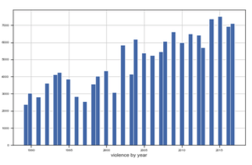
Preliminary Exploration and Findings
There is an increase in violence

Slide 7
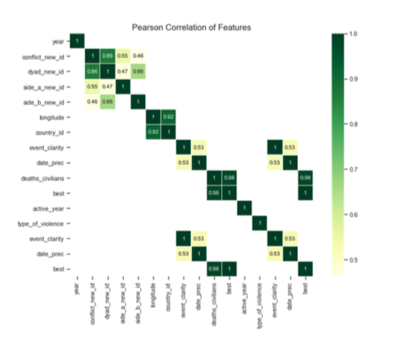
Pearson Correlation graph shows that there is a strong relationship between the events clarity and reporting time. I take in consideration of correlation that is greater or equal to 0.5 or less than or equal to -0.4.

Slide 8
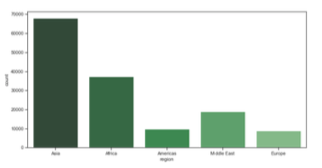
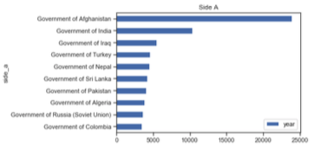
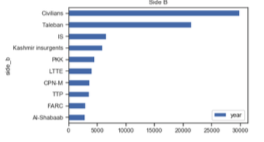
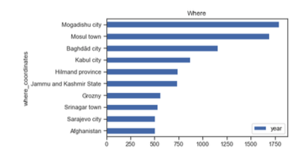
As seen in below graphic, 8 out of the first ten countries that involved in a conflict are in Asia. What is the main reason behind Asian conflicts?

Slide 9
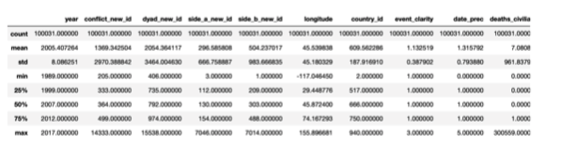
Model Approach
Data split into 70% training and 30% testing set.
Mean absolute error (MAE) used as metric.
The baseline guess is a score of 45.8 and baseline performance on the test set is MAE = 32.3763. This shows our average estimate on the test set is off by about 32 points.

Slide 10
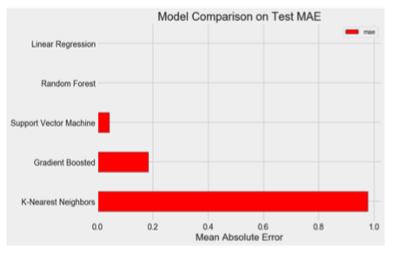
To develop a model that can predict the conflict.
A supervised regression task to develop a model that can predict the conflict.
The results presented below:
Linear Regression Performance on the test set: MAE = 0.0000
Support Vector Machine Regression Performance on the test set: MAE = 0.0424
Random Forest Regression Performance on the test set: MAE = 0.0018
Gradient Boosted Regression Performance on the test set: MAE = 0.1832
K-Nearest Neighbors Regression Performance on the test set: MAE = 0.9770

Slide 11
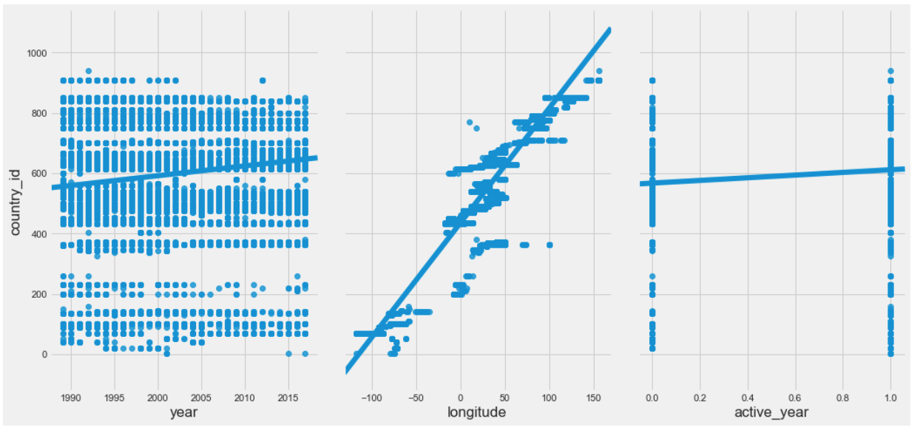
Linear Regression used as a model optimization, and as seen in the graph, there is a strong relationship between longitude and country _id.

Slide 12
The data split into 70% of training, 30% testing set, and the slope and intercept of the data contained in the model's fit parameters. The interception of the model is 435.83437, and the slope is 3.80887. Means that for every one unit of change in country_id, the change in the longitude is about 3.80%.
Mean Absolute Error: 53.00359
Mean Squared Error: 5611.81805
Root Mean Squared Error: 74.91206
The root mean squared error is 74.91, which is higher than the mean value of the longitude of all states, which is 45.58. The result means that our algorithm was not very accurate but can still make reasonably good predictions.

Slide 13
Conclusion
Many factors may have contributed to this inaccuracy like we need more data, or we made the wrong assumption that this data has a linear relationship. Another reason might be the poor features we used may not have had a high enough correlation to the values we were trying to predict.
The essential causes of war are found in the nature and behavior of man. Conflicts result from selfishness, from misdirected aggressive impulses, from stupidity. If these are the primary causes of war, then the elimination of war must come through uplifting and enlightening men or securing their psychic-social readjustment.

Slide 14
Resources
https://www.prio.org/Data/Armed-Conflict/
https://ourworldindata.org/war-and-peace
https://ucdp.uu.se
https://www.theobjectivestandard.com/2014/10/causes-war-peace/
Jupiter Notebook

Slide 15
Thank you
Mehmet J Oguz
www.linkedin.com/in/mjoguz

